Slide 1
ARTIFICAL INTELLIGENCE
MUHAMMAD TAHA

Slide 2
ARTIFICAL INTELLIGENCE
Artificial Intelligence (AI) is a branch of computer science that focuses on creating machines and software capable of performing tasks that normally require human intelligence. These tasks include learning, reasoning, problem-solving, decision-making, and understanding natural language.

Slide 3
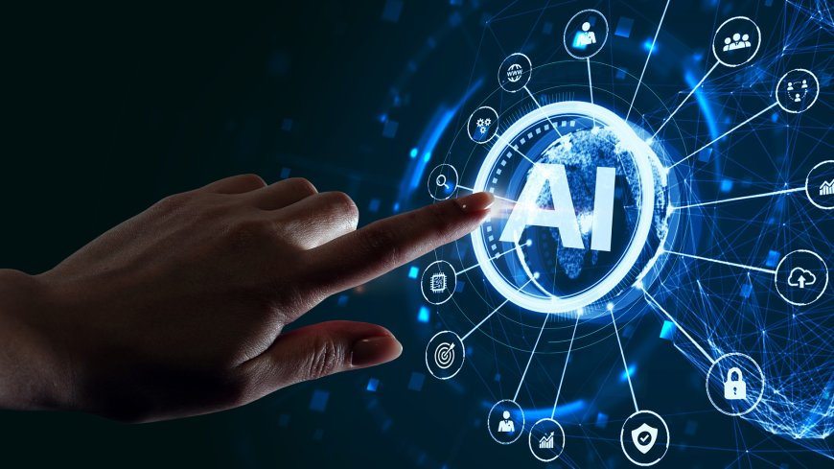
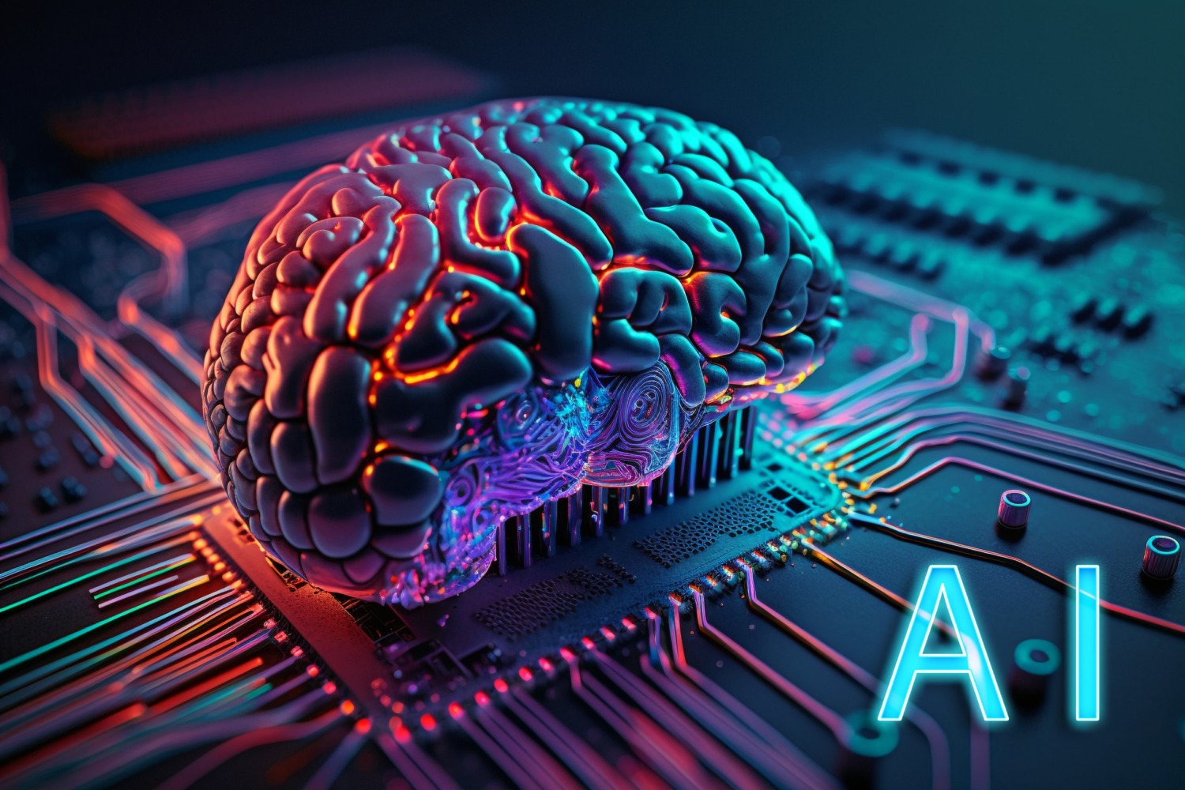
Artificial Intelligence (AI)

Slide 4
Table
SAP ID | NAME | SECTION
5000001413 | AHMED | A
5000005757 | HAMZA | D
5000009876 | SAMI | E

Slide 5

Screenshots

Slide 6
Smart Art
INPUT
PROCESSING
OUTPUT

Slide 7

Video

Slide 8

Audio
Press This

Slide 10
DIFFERENCE
CPU
MOTHER BOARD
The CPU is the brain of the computer. It performs all the processing of data and instructions. The CPU carries out three main functions:
Fetch – Takes instructions from memory.
Decode – Understands the instructions.
Execute – Performs the required task.
The Motherboard is the main circuit board of the computer. It connects and holds all important components, including the CPU, memory (RAM), storage, input/output devices, and expansion cards.

Slide 11

COMPUTER
A computer is an electronic machine that can store, process, and display information. It works according to the instructions given by the user through programs and software. A computer performs four basic functions: input, processing, output, and storage.

